Slide 1

Your Interactive Student Notebook
One notebook. Every idea you build this year.
DR. IJEZIE · MATH & SCIENCE

Slide 2
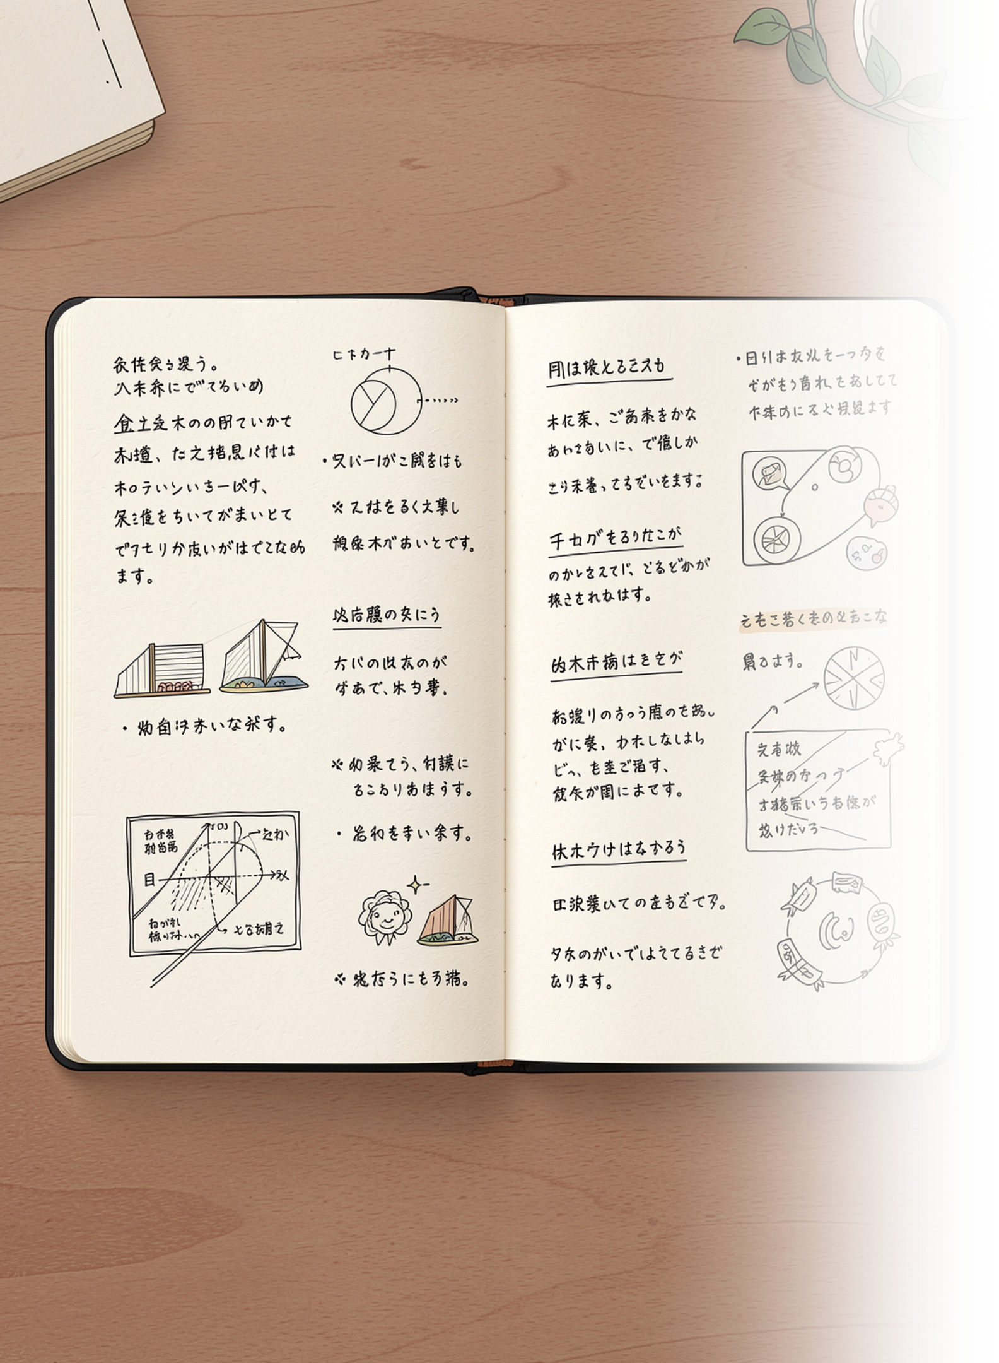
Why We Use an ISN
This notebook is not a folder. It is not a place to store loose paper. It is where your thinking gets built — structured, visible, and yours.
The Two Sides Have Two Jobs
The Research Is Clear
Writing about new material, drawing diagrams, and summarizing in your own words physically moves information into long-term memory. Passive note-taking does not. Your ISN is the tool that makes the active side happen — every single class.
The right side is what you receive from instruction. The left side is what you do with that information. You need both. Receiving alone is not learning.

Slide 3





What You Need
Gather these five things before the next class. Every item earns its place — here is why each one matters.
Composition Notebook
Glue Stick
Scissors
Sewn binding only — no spiral. Sewn pages cannot tear out. Your work stays intact for the whole year. Spirals leave ragged edges and loose pages disappear.
Handouts get glued directly onto your pages — flat, secure, and part of the notebook. Staples rip pages. Tape peels. A glue stick is the right tool.
You will trim handouts to fit your pages neatly. A clean cut makes a big difference in how organised your notebook feels — and how easy it is to read.
Coloured Pencils or Markers
Pen and Pencil
Colour is a thinking tool, not decoration. You will use it to code concepts, highlight relationships, and create diagrams that your brain remembers.
Pen for permanent notes and entries. Pencil for diagrams, sketches, and anything you want to revise. Keep both in your bag every day.

Slide 4

Step One: Number Every Page
Before you write a single note, number every page. This is the first thing you do with a brand-new notebook — no exceptions.
How to Do It
Why It Matters
Open the notebook flat to the first sheet
The front of that sheet is Page 1
Flip it over — the back is Page 2
Continue through the entire notebook
Write the number in the bottom outer corner of each page
Every entry in your Table of Contents links directly to a page number. If your pages are not numbered, your Table of Contents is useless and finding anything becomes impossible. Numbered pages turn a notebook into a reference system.
Do It Now, Not Later
Numbering after the fact is painful. Numbering before anything is written takes about four minutes. There is no good reason to wait.
Bottom outer corner means: bottom-right on right-hand pages, bottom-left on left-hand pages. Every page gets its own number. Front and back are separate.

Slide 5
Pages 1–4: Your Table of Contents
The front and back of your first two sheets — four pages total — are reserved exclusively for the Table of Contents. Do not write class notes here. These pages are your index.
Rule Three Columns on Every TOC Page, Labelled Exactly:
DATE
ASSIGNMENT NAME
PAGE NUMBER
8/25
Do Now: Angle Pairs
6
8/25
Guided Notes: Types of Angles
7
8/27
Vocabulary: Linear Pair & Vertical Angles
8
8/28
Lab: Measuring Angles Activity
10
Log every entry the moment you begin it — not at the end of the week. Your TOC is only useful if it is current.

Slide 6

Page 5: Leave It Blank
Pages 1–4
Page 5
Page 5 is your buffer page. You do not write on it during normal class operation.
Table of Contents
Buffer — leave blank
What It Is For
Page 6 →
If your Table of Contents on pages 1–4 fills up before the year ends, it continues here. This is a planned overflow — not a mistake. A full Table of Contents is actually a sign that your notebook is doing its job.
All real content begins here
What It Is Not For
Not for doodles
Not for homework
Not for extra notes that spill over from page 6
If Page 5 stays blank all year, that is perfectly fine. It is insurance — every well-designed system has a margin.

Slide 7

All Real Content Starts on Page 6
Page 6 is where your academic year begins. Every Do Now, every set of guided notes, every lab entry, every diagram — it all starts here and builds forward from this point.
Log It the Moment You Start
Every Entry Has a Date
No Skipping Pages
The instant you begin writing on a new page, open your Table of Contents and log it: date, assignment name, page number. Do not wait until the end of class. Do not do it "in a minute." Log it now.
Write the date at the top of every new entry. If you work across two class periods, date each section separately. Dated entries tell the story of your learning over time.
Work continuously. If an activity ends mid-page, the next activity picks up right below it — not on a fresh page. White space in a notebook is wasted thinking space.

Slide 8
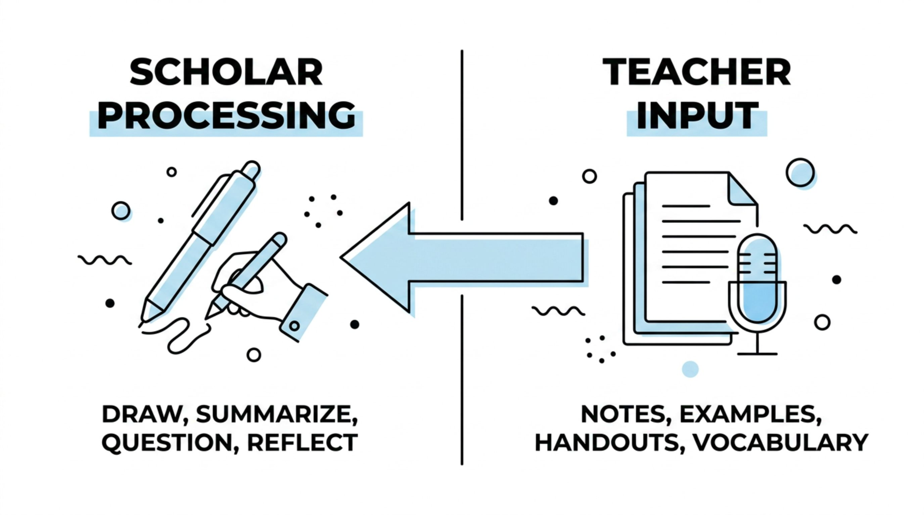
The Two-Page System
Every time your notebook lies open flat, you are looking at a two-page spread. These two pages always work as a pair — they cover the same content from two different angles.
The right page is what came into your brain. The left page is what your brain did with it. You always complete the right side during class, and you complete the left side by the next class meeting.

Slide 9






Right Side — Teacher Input
WHAT YOU RECEIVE
The right page is the record of instruction. Everything that comes from the teacher, the board, or the handout goes here. This is your primary source — keep it organised and complete.
Do Nows
Guided Notes & Graphic Organizers
The warm-up problem that opens every class. Write it here as you work it.
Structured notes provided during direct instruction. Fill them in completely.
Worked Examples
Vocabulary & Definitions
Problems the teacher models step-by-step. Copy every step — do not skip the ones that seem obvious.
Key terms with precise mathematical or scientific definitions, exactly as introduced.
Foldables & Handouts
Theorems, Formulas & Anchor Charts
Trim and glue them in flat. They become permanent parts of the page.
Copy anything written on the board that is not provided on a handout.

Slide 10


Left Side — Scholar Processing
WHAT YOU DO WITH IT
The left page is yours. This is where learning actually happens. It is never a copy of the right side, and it is never blank. Pick the strategies that work for the content — you do not have to use all of them every time.
Drawings & Diagrams You Create
Sketch the concept from memory or in your own visual style. Label it yourself.
Summary in Your Own Words
Explain the main idea as if you are teaching it to someone who missed class.
Concept Map or Colour-Coding
Show how ideas connect. Use colour deliberately — one colour per concept, consistently.
Your Own Worked Example
Invent a problem with different numbers than the teacher's. Solve it completely.
Where I Got Stuck & Questions I Still Have
Name the exact moment or concept that felt unclear. Write the question precisely.
Reflection on Your Thinking
What changed in how you understood this topic? What surprised you? One to three sentences is enough.
A left side that only repeats the right side earns no credit. The left side must show your mind working.

Slide 11


A Finished Spread: What It Looks Like
Here is a real example of a complete two-page spread on angle relationships. Use this as your benchmark.
RIGHT PAGE — Teacher Input
LEFT PAGE — Scholar Processing
Do Now (8/25)
Guided Notes: Angle Relationships
My Own Diagram
Identify each angle pair: ∠1 and ∠2 share a ray and form a straight line. Answer: Linear Pair.
Two intersecting lines drawn and labelled. Vertical angles shaded in matching colours. Arrows showing supplementary pairs adding to 180°.
Vertical angles are congruent. Linear pairs are supplementary (sum = 180°). Complementary angles sum to 90°. Teacher example: If ∠A = 65°, then its supplement = 115°.
Summary in My Words
"When two lines cross, the angles across from each other are always equal. The angles next to each other always add to 180°."
Question I Still Have
"Does this rule still work when more than two lines cross at the same point?"
Notice: the left side is not a copy. It is a response — proof that the scholar engaged with the material.

Slide 12
Notebook Rules
These are not suggestions. They are the operating standards for every scholar in this class.
1
Date Every Entry
Write the date at the top of each new entry, every time. No date means no record of when the work happened.
2
Log in the TOC Immediately
The moment you begin writing on a new page, open to pages 1–4 and log it. Not at the end of class. Now.
3
Glue Handouts In — No Exceptions
Staples tear pages. Loose papers fall out and disappear. Every handout gets trimmed and glued flat onto the page it belongs on.
4
The Notebook Stays in the Classroom
Unless Dr. Ijezie explicitly tells you to take it home, your notebook lives in this room. It is a classroom tool, not a travel item.
5
If You Are Absent — Catch Up Yourself
Get the right-side notes and page numbers from a classmate. Complete the left side on your own. Absences do not excuse blank pages.

Slide 13

How Your Notebook Is Checked
Notebook reviews happen regularly. Here is exactly what Dr. Ijezie looks for — and what does not factor into your grade.
What Is Checked ✓
What Is Not Checked ✗
Left side completeness — Is the scholar processing page substantive and present for every entry?
Table of Contents accuracy — Is every entry logged with the correct date and page number?
Dated entries — Does every page carry the date it was worked on?
Handouts glued in — Are all provided materials secured to the page?
Neatness of your handwriting
How artistic your diagrams are
Whether your summary is eloquent
The colour of your pen
The Standard Is Simple
Did you show up on both sides of the page? Did you track your work? Did you date it? If yes — your notebook is doing its job. Completeness and honesty of effort are the only metrics that matter here.
A blank left side is the only thing that will cost you marks. Everything else is yours to own.

Slide 14

"If your left side is blank, the learning has not happened yet."
Your notebook is the most honest record of your thinking that exists. Fill it like it matters — because it does.
DR. IJEZIE · MATH & SCIENCE · GRADES 9–12

